Slide 1


Challenge #6
Daily CSI
Spot the Differences
Play Time
8th Grade Forensic Science
T. Trimpe 2008 http://sciencespot.net/

Slide 2
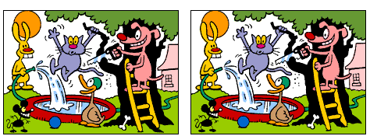
Find the 6 differences between the two pictures.
Source: http://www.slylockfox.com/arcade/6diff/index.html

Slide 3
The answers are …
Answers: Root, dog’s teeth, leaves, ladder rung, nozzle, rabbit’s head
Source: http://www.slylockfox.com/arcade/6diff/index.html

